Slide 1
Diabetes Classification
Using Machine Learning
Lithigesh P G – [CB.EN.U4CCE23025]
Nivas G – [CB.EN.U4CCE23030]
Praveen S – [CB.EN.U4CCE23035]

Slide 2
Bi-Weekly Plans
Week 1-2: Understanding the Dataset and Pre-processing - Perform data preprocessing such as label encoding, handling missing values, removing duplicates and handling class imbalance using SMOTE.
- Handling outliers, normalization and feature selection and extraction.
Week 3-4: K-Means clustering and KNN - Implementing machine learning model for diabetes classification such as K-Means clustering and KNN (K Nearest Neighbors).
Week 5-6: Logistic Regression and Decision tree - Performing logistic regression for multiclass diabetes classification. - Implementing decision tree using gini index as split criterion.

Slide 3
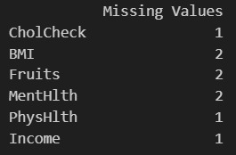
Data Pre-processing
ENCODING:-
- Label encoding for categorical columns
MISSING VALUES:-
DUPLICATES HANDLING:-

Slide 4
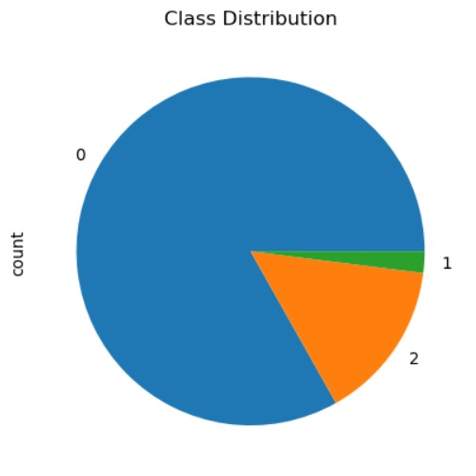
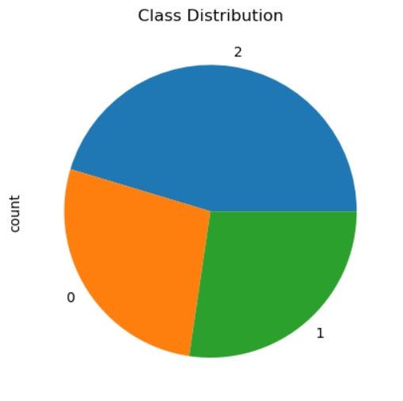
Data Pre-processing
CLASS IMBALANCE HANDLING USING SMOTE:-

Slide 5

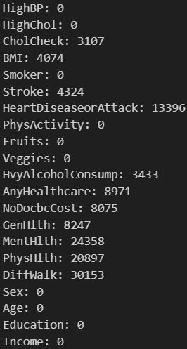
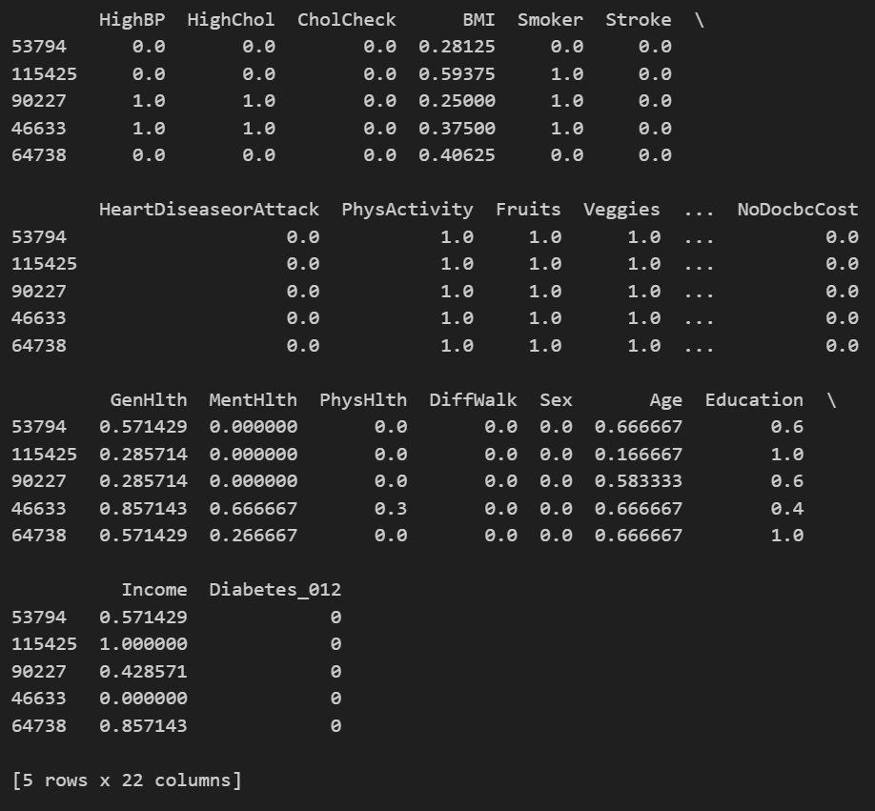
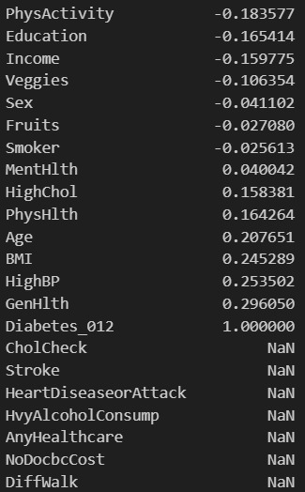
OUTLIER HANDLING:-
NORMALIZATION:-
FEATURE EXTRACTION:-

Slide 6
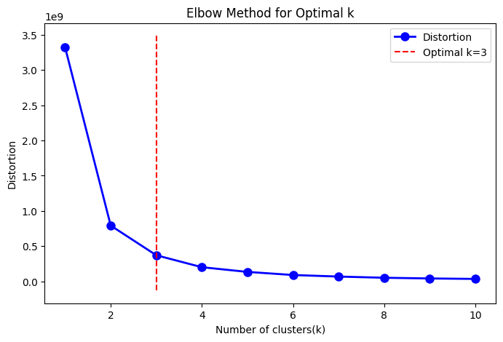
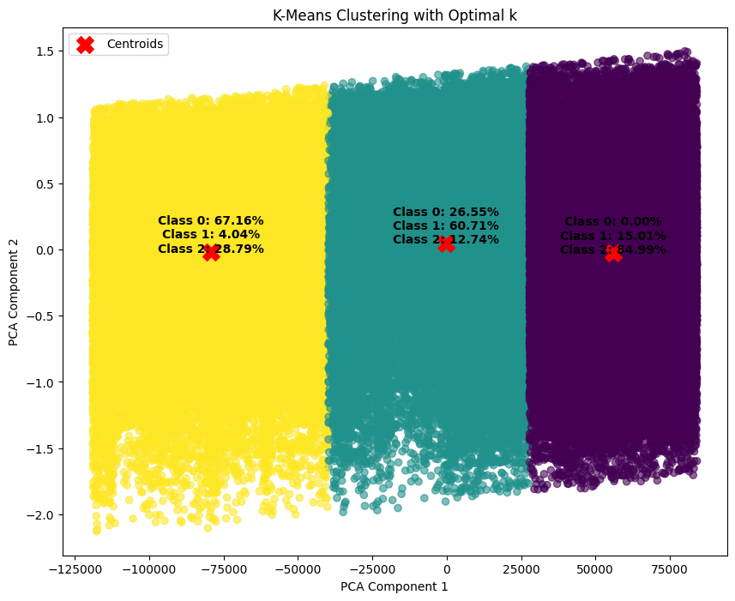
K – Means Clustering

Slide 7
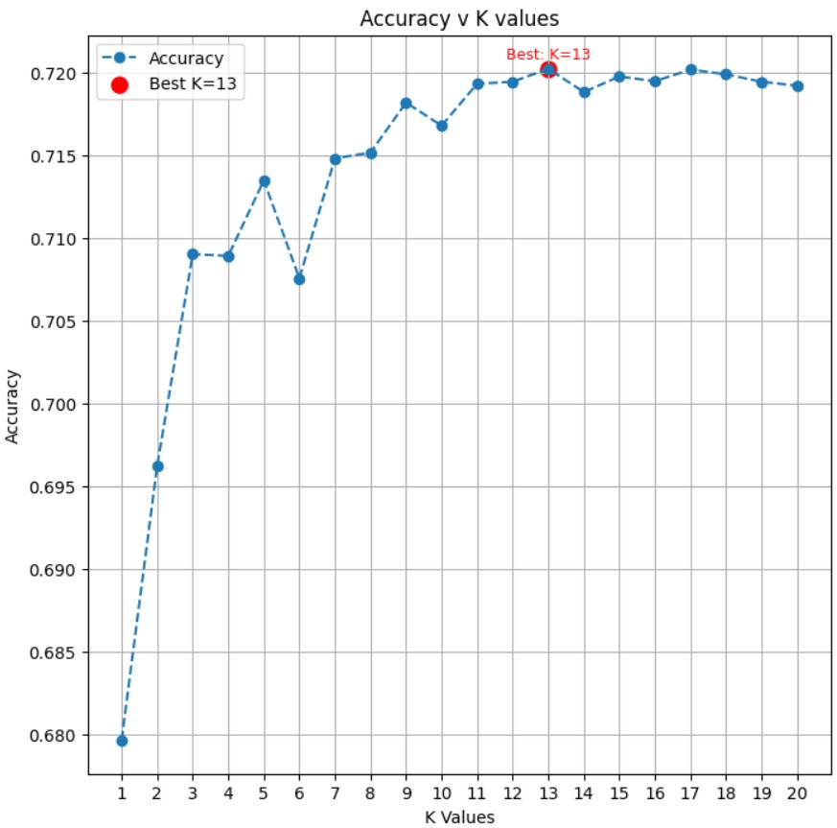

K Nearest Neighbors

Slide 8
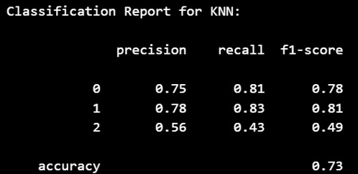
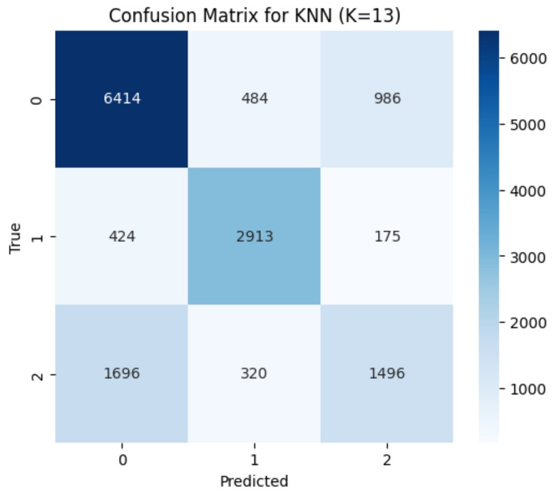
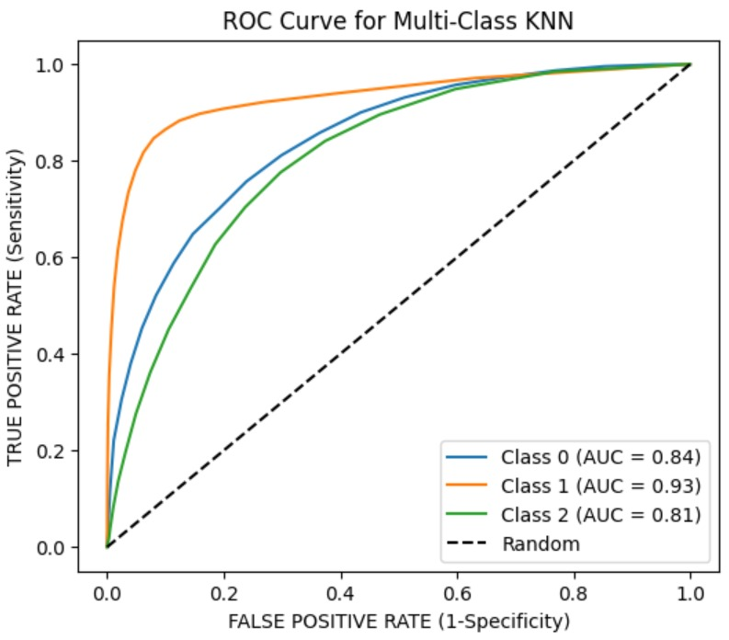
K Nearest Neighbors

Slide 9
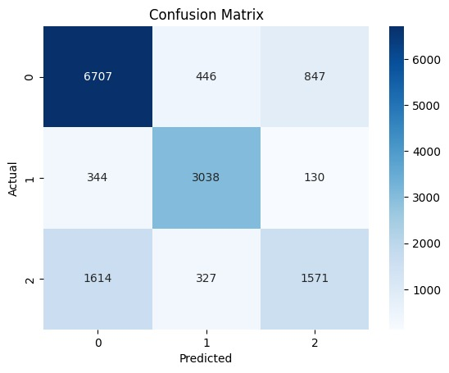
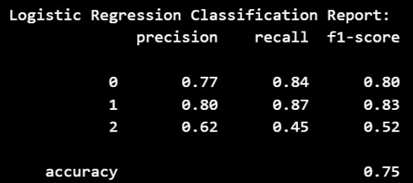
Logistic Regression

Slide 10
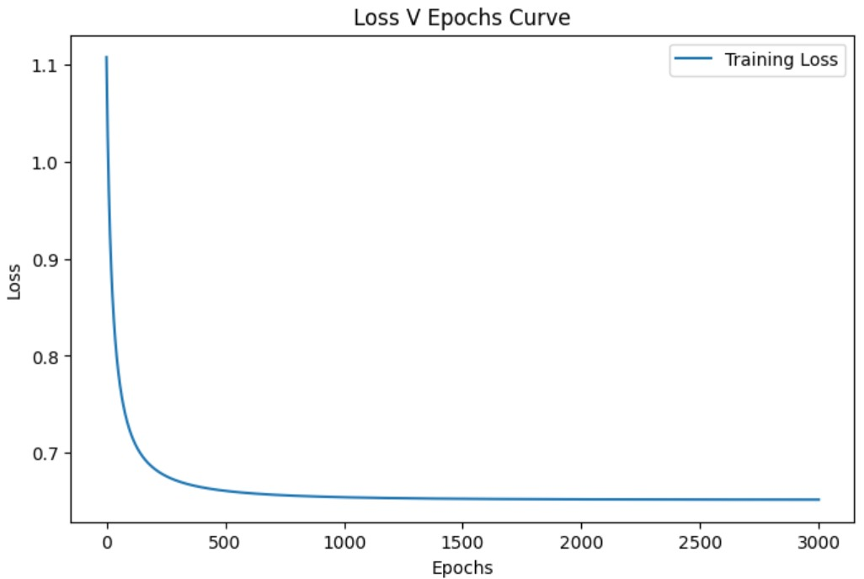
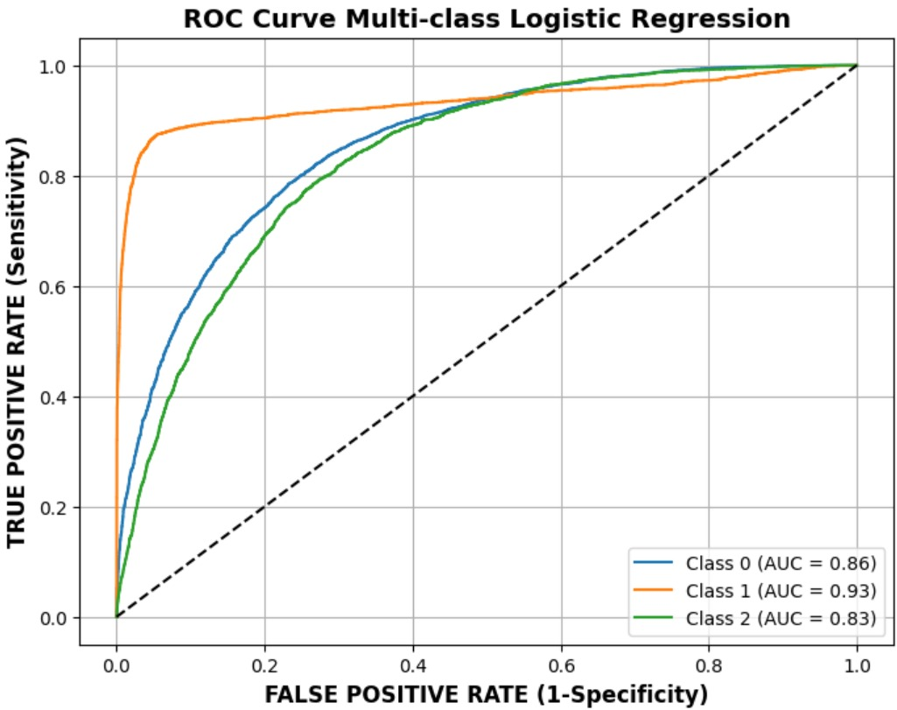
Logistic Regression

Slide 11
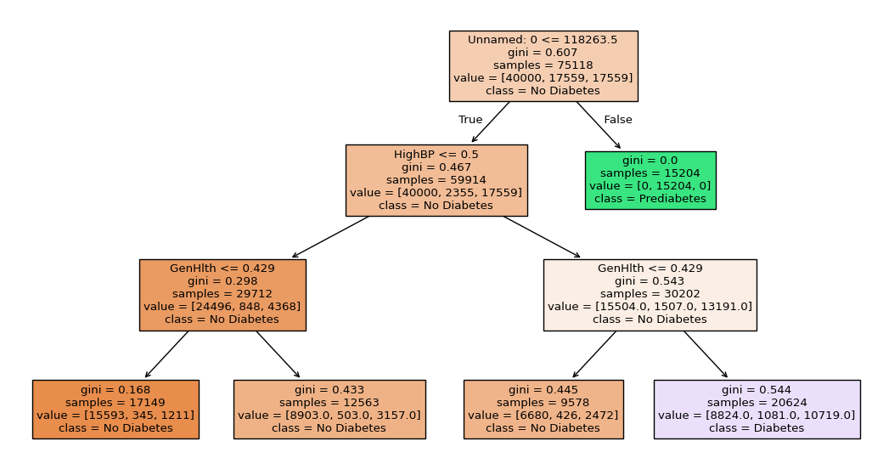
Decision Tree

Slide 12
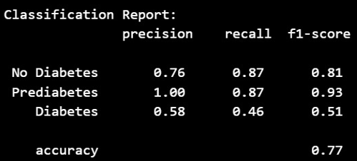
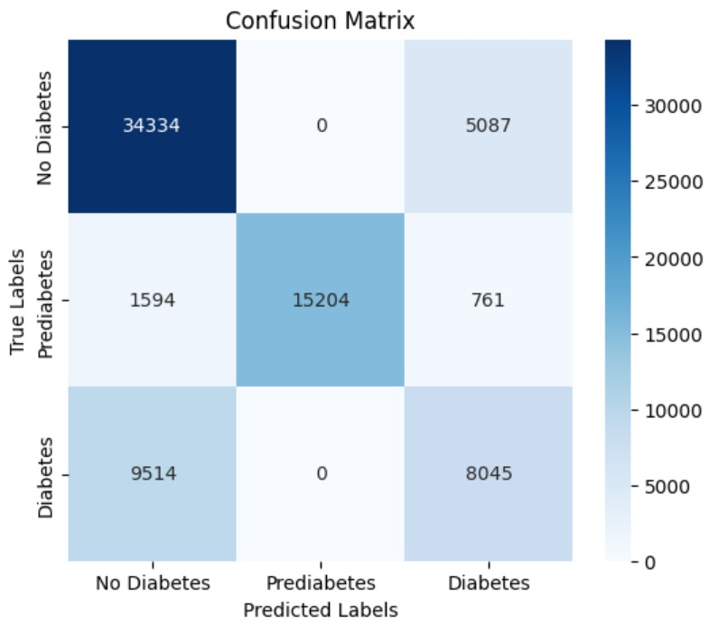
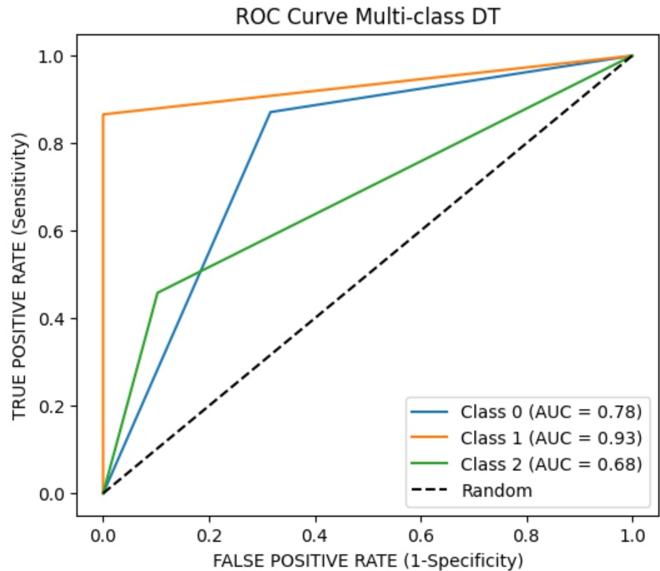
Decision Tree

Slide 13
Thank You

